Slide 1
Light and Dark in ICUs: Circadian Disruption, Delirium, and Recovery Outcomes
Sarah Deckarm

Slide 2
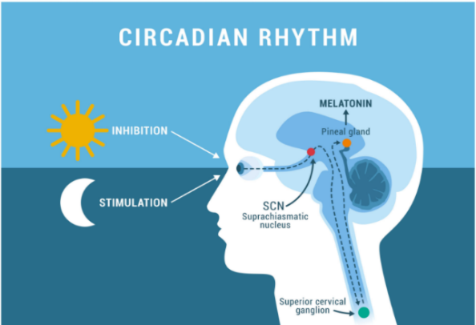
Circadian Rhythm
Healthy individuals have strong daytime light and darkness at night to keep the suprachiasmatic nucleus (SCN) well regulated and promote robust melatonin/cortisol rhythms
(Potter et al., 2016)
Circadian Rhythm And Sleep. The biological rhythms are a natural… | by Dr Sadia Asad | Medium

Slide 3
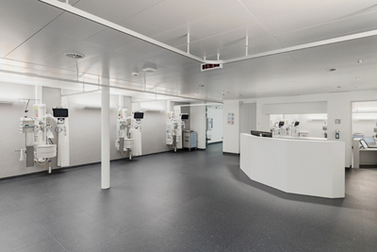
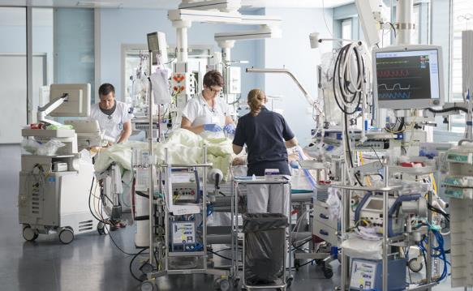
I worked in two hospitals in Bern….
Beau Site Bern, fully underground, no natural light
Inselspital Bern, two zones (one with natural light and one without)
Much higher patient volume and complexity

Slide 4
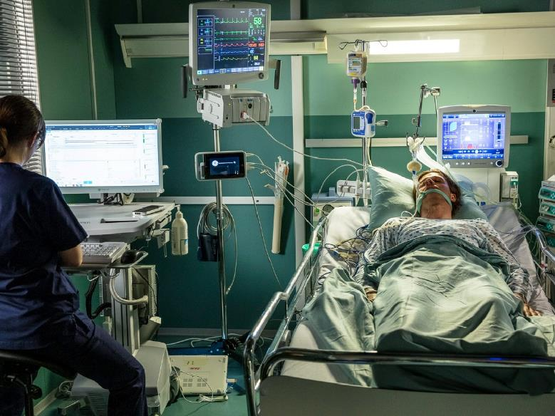
In both nights looked something like this…

Slide 5
Circadian disruption in ICUs
Evidence suggests that typical ICU lighting (dimly lit days, intermittent bright night light for care tasks) disrupts circadian rhythms (Intihar et al., 2021; Jobanputra et al., 2020).
Circadian misalignment is linked to delirium and slower recovery (Madrid-Navarro et al., 2015; Li et al., 2023).
May be explained by a melatonin/cortisol dysregulation.

Slide 6
Current trials
!
Observational data suggest that natural light exposure reduces delirium and shortens stay (Lee et al., 2020; Jafarifiroozabadi et al., 2022).
In a small pilot RCT, Gehlbach et al. show that scheduled bright light can re-entrain circadian timing (2018).
Yet, there is a lack of high-quality multicenter RCTs

Slide 7

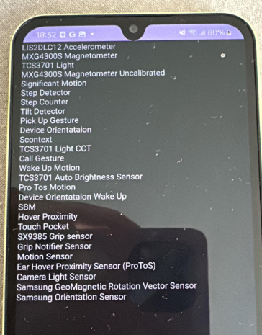
IDEA!
Notes:
Using the Light sensor on the phone could be very helpful in this case!
Could help us evaluate illumination at approximately patient eye level in different ICU zones and bed locations

Slide 8
IDEA!
Standard lux sensor
Color temperature sensor
Adjust screen brightnes based on lux + CCT
Optimizing exposure/flash lighting conditions
Notes:
Using the Light sensor on the phone could be very helpful in this case!
Could help us evaluate illumination at approximately patient eye level in different ICU zones and bed locations

Slide 9
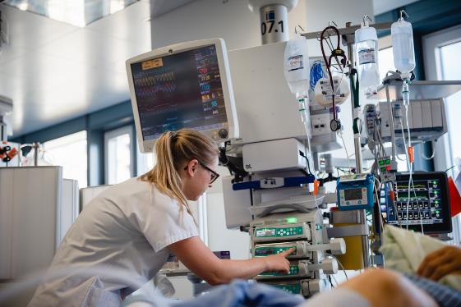
Harnessing the Android Phone Sensor Data
Light-dark patterns may be especially relevant in the severely ill population of ICU patients (frequently sedated, on mechanical ventilation, severely ill, with a continuous noise background)
Strategically implement ICU lighting: maximizing daytime brightness and minimizing nocturnal light may help restore adult ICU patients’ circadian rhythms, potentially lowering delirium risk and improving recovery (composite of ICU survival and coma-free state at ICU discharge).

Slide 10


A Light sensor on the phone could be very helpful in this case!
!
Evaluate illumination in different ICU zones, beds etc. at approximately patient eye level
Implement an early-warning system (nursing staff, physicians) if there is excessive bright light during night time
Examine the correlation between light exposure data with clinical outcomes such as delirium incidence, death on ICU and length of ICU stay

Slide 11
Findings

Slide 12
Day vs. Night Illuminance
Average Illuminance
ICU light: 150.78 lx
ICU dim: 11.43 lx
Illuminance was measured in short 20–45 second sequences at several beds and locations within the same ICU Zone (Zone 2)
These short tests demonstrate a clear light–dark contrast within the same ICU zone, which may be leveraged for circadian rhythm support in critically ill patients.

Slide 13
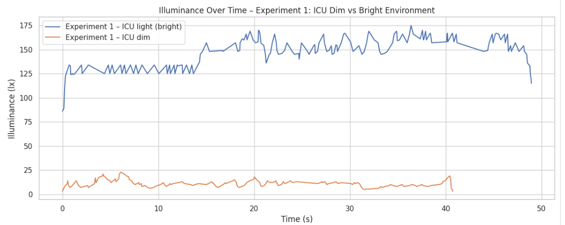
Corresponding light and dim recordings

Slide 14
Indoor vs. Outdoor Illuminance
Average Illuminance
ICU Zone 1 (Indoor, day): 160.46 lx
Outdoor next to ICU Zone 1: 17236.18 lx
On Zone 1, light was measured both just outside the window on a sunny day, as well as at a bed without direct window access)
Despite the presence of windows, indoor light levels remain over 100× lower than natural daylight
insufficient Circadian stimulus indoors even during daytime

Slide 15
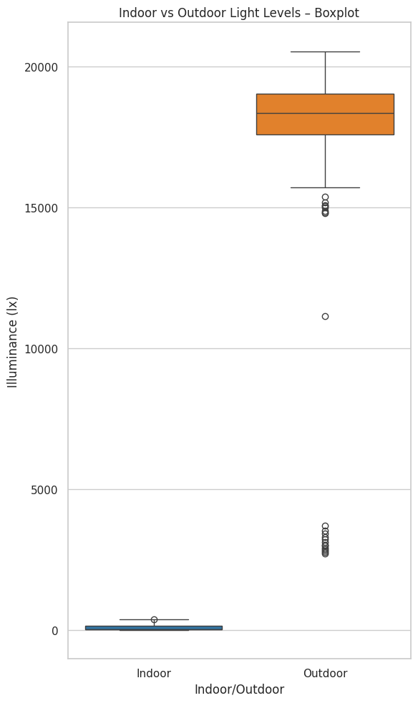
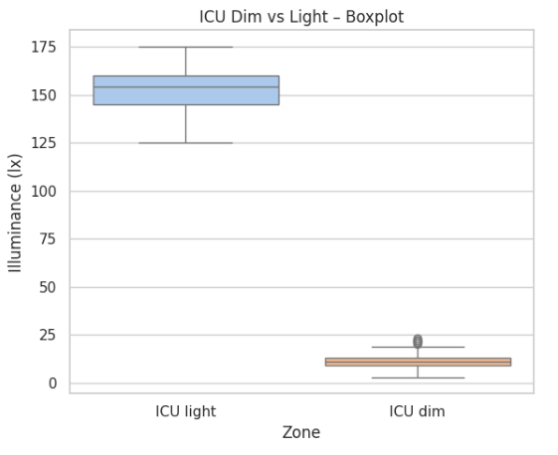
Boxplots

Slide 16
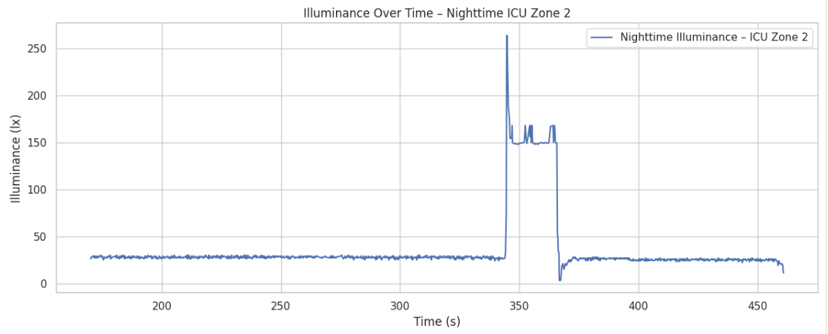
Night time bright spikes:
I could record one bright night-time Illuminance spike:

Slide 17
Conclusion

Slide 18
!
Our (Inselspital, Bern) ICU patients experience inadequate daytime light and disturbing night-time light, both of which can impair circadian rhythms, increase delirium risk, and delay recovery.

Slide 19
Comparison to other literature:
Previously Reported – Manchester ICU Study (Durrington et al., 2017)
Similar to our findings
ICU light levels were orders of magnitude dimmer than natural light
Frequent overnight light interruptions were also reported
Lighting Phase | Measured Illuminance (lux)
Daytime (mean) | 158.9 ± 0.468 lux
Night-time (mean) | 10.44 ± 0.153 lux

Slide 20
Relevance I
The mean daytime light intensity measured across ICUs (ca. 150lx) was low in comparison to natural daylight → orders of magnitude dimmer than day light!
but…
“A light intensity of 1000 lux is enough to entrain circadian rhythm.”
We are lacking this intensity of light!

Slide 21
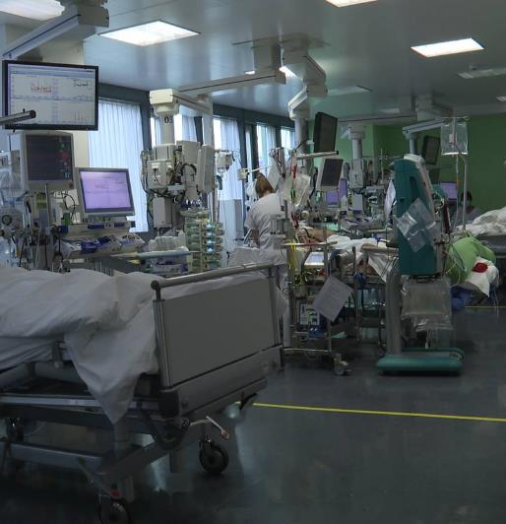
Relevance II
Night time bright light can promote delirium
Delirium is both common (1/3 of all ICU patients) and dangerous.
It is a strong predictor of mortality (ca. doubled with delirium) and prolonged ventilation, ICU and hospital stay, as well as worse long-term cognitive outcomes (Salluh et al., 2015)

Slide 22
Future Outlooks

Slide 23
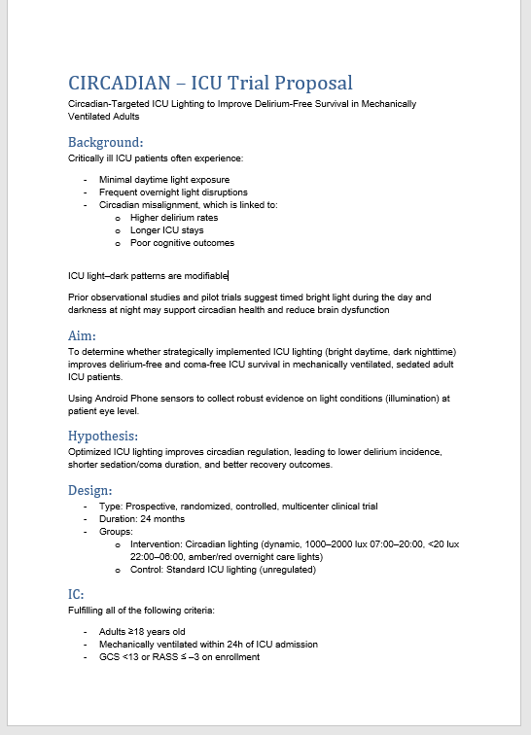
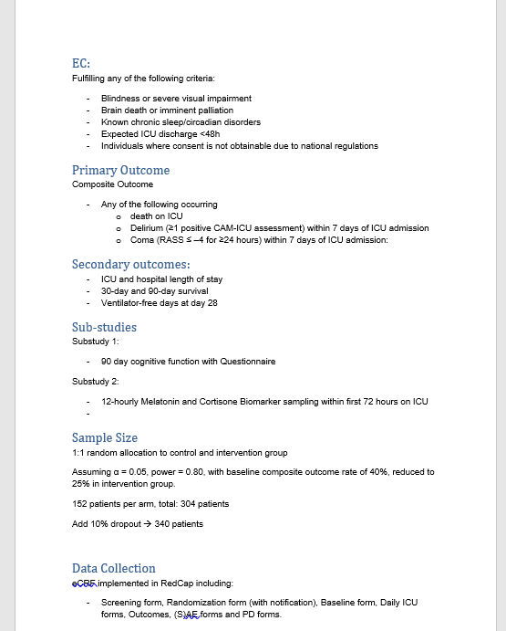
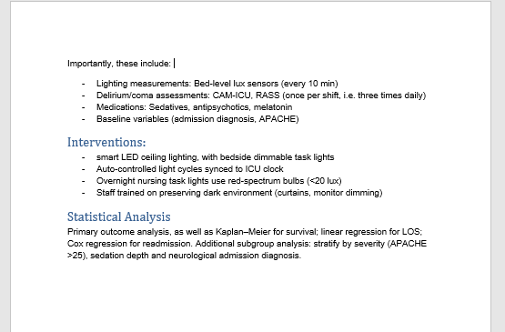
CIRCADIAN-ICU Trial (proposal ☺)

Slide 24
Thank you!
Notes:
Images:
Die Universitätsklinik für Intensivmedizin - Universitätsklinik für Intensivmedizin
Qualitätssicherung – Intensivpflegestation
Circadian Rhythm And Sleep. The biological rhythms are a natural… | by Dr Sadia Asad | Medium

